Slide 1

DISCERNMENT
Seeking God’s guidance in our cwl life
The Catholic Women’s League of Canada
London Diocese
Prepared by Rebecca McCarrell, Past President, London Diocese
Adapted from A Short Exercise on Discernment
And Affirming Workshop
Notes:
Hello everyone, and welcome to this workshop on Discernment…Seeking God’s Guidance in our CWL life
Let’s open with our League Prayer: Together: In the name of the Father, Son and Holy Spirit…We humbly pray You, O God…….Amen
Next slide

Slide 2
We humbly pray You, O God our Father,
to bless The Catholic Women’s League of Canada.
Bless our beloved country,
our homes and families.
Send Your Holy Spirit upon us
to give light to our minds
and strength to our wills
that we may know and fulfil
Your great law of charity.
Teach us to share with others
at home and abroad
the good things You have given us.
This we ask through our Lord Jesus Christ
and the intercession of our patroness,
Our Lady of Good Counsel.
Amen
Notes:
We humbly pray You…..Amen
In our League Prayer we have asked Creator God to “Send your Holy Spirit upon us to give light to our minds and strength to our wills…” And he will, And He does.
The Spirit works within us and shows us what He wants us to do and be, nudges us, leads us and pulls us.
Next Slide

Slide 3
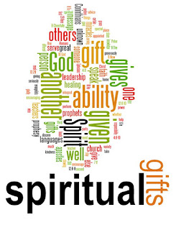
Everyone has been gifted by God.
The gifts we have are not the same as the gifts others have.
All gifts are precious, none is greater than another.
This Photo by Unknown Author is licensed under CC BY-NC
All gifts fill a part of God’s plan for His people.
Notes:
We have been gifted by Creator God, gifted with charisms, gifts that are given to be used for others, special gifts for the good of others. God calls all of us to recognize, develop and use these gifts…in our journey with our sisters and with Christ in the League.
We begin with the following premises:
Click
Everyone has been gifted by God …. Take a moment and think about what gifts you have….it could be making pies, taking care of a neighbour, providing food for the poor, or maybe just praying.
Click
The gifts we have are not the same as the gift's others have….now think of a gift that someone else has that you don’t…singing, reading at church, teaching, computer whiz, leaders and workers.
Click
All gifts are precious, none is greater than another. Can you imagine how difficult this world would be if everyone was able to do the same job and other jobs were left by the wayside? God is insightful and has scattered these gifts among us. All gifts are needed to make our lives work…and we support each other with our various gifts.
Click
All gifts fill a part of God’s plan for His people…. God’s plan for us as CWL members is supporting an organization that has much meaning behind it…gifts to support our mission statement and our objectives.
(Short silence, then quietly)
Be still within and without. Let us place ourselves in the presence of the Lord. God is here with us now
Next slide

Slide 4
Father, Creator God, who formed us in your image and gifted us;
Jesus, Saviour God, who came and walked with us and shows the way;
Holy Spirit who inspires us and gives us the courage
to be all that we can be;
we ask that You bless us today as we come together,
to prayerfully discern our giftedness.
Open our hearts to your invitation to use these gifts as we continue to journey as members of The Catholic Women’s League of Canada, in the service of God and of all God’s people.
Glory be to the Father, and to the Son and to the Holy Spirit,
as it was in the beginning, is now and ever shall be, world without end. Amen
Notes:
Let us pray together:
(Take a breath….then move to Next Slide)

Slide 5
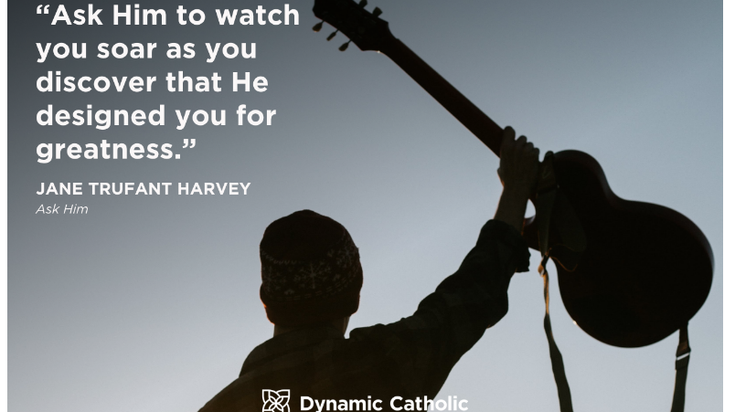
Notes:
Jane Trufant Harvey in her book, Ask Him, encourages us to discover and soar! How can we do that? Prayer and following the Objects of the League
Next slide

Slide 6
Objects of the League
The objects of the League shall be to unite Catholic women of Canada
To achieve individual and collective spiritual development
To promote the teaching of the Catholic church
To exemplify the Christian ideal in home and family life
To protect the sanctity of life
To enhance the role of women in the church and society
To recognize the human dignity of all people everywhere
To uphold and defend Christian education and values in the modern world
To contribute to the understanding and growth of religious freedom, social justice, peace and harmony
Notes:
Let’s look at the Objects of the League
Click
The objects of the League shall be to unite Catholic women of Canada. How many of you have been to events, conventions meetings outside of your council? This is where we are united. We also work together on various issues through our standing committees so that we are united in our work for God and Canada.
Click
To Achieve individual and collective spiritual development. It is important to our membership that we bring spiritual aspects into our meetings, conventions and everything we do. We introduce new music, new prayers, as well as celebrating all the sacraments and foundations of our faith.
Click
To promote the teachings of the Catholic Church….our foundation is the teaching of the church. We want to keep these foundations in everything we do.
Click
To exemplify the Christian ideal in home and family life….our actions speak louder than words! As a CWL member, we should show our own families how important our values are and attempt to instill them in our family life!
Click
To protect the sanctity of life….from conception to natural death, we support the right to life at all stages.
Click
To enhance the role of women in church and society…as women, we must show our younger generation how important it is to be seen and heard. That their thoughts, their actions and their abilities are needed to make this world a well-rounded society.
Click
To recognize the human dignity of all people everywhere….the person on the street struggling with addictions….the young person with mental health problems…those unable to care for themselves…and those who have nothing…they are all God’s children and as such deserve to be treated with love and respect.
Click
To uphold and defend Christian education and values in the modern world…this is a battle that has been increasing of late…our education system at this time is not in support of our Christian values. We must fight to bring God back to school, to keep our schools open for our children and our future children.
Click
To contribute to the understanding and growth of religious freedom, social justice, peace and harmony. Such a strong statement! Social justice issues are on the rise, and one of our new pillars is dedicated to these issues.
Pause
What are we supposed to be doing? We need to be looking at the objects of the League, choose one that is closest to your heart at this moment in time. Write it down so that we can refer to it later.
Next slide.

Slide 7
Our Mission Statement
The Catholic Women’s League of Canada calls its members to grow in faith, and to witness to the love of God through ministry and service.
Notes:
Recently, with the examination at our National level of the standing committees roles and responsibilities, our Mission statement has been updated.
Click
(Read Mission Statement)
This is who we are as CWL members…Who are you? Do you see yourself fitting into the League to grow in Faith through Ministry and Service?
Think of the objects that we just went over…Do you fit into the object that you chose as the closest to your heart?
Next slide

Slide 8
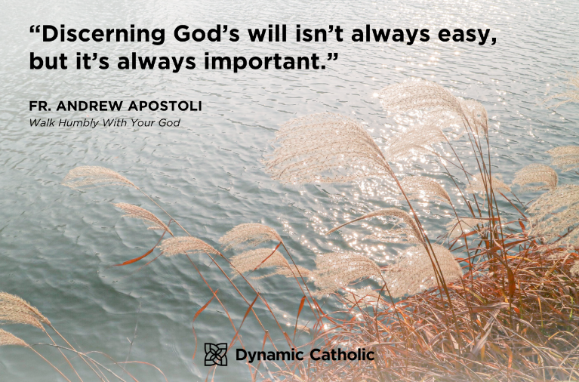
Notes:
What is discerning?
Fr. Andrew Apostoli describes it as Meeting people where they are . . . Leading them to where God calls them to be! “Discerning God’s will isn’t always easy, but it’s always important.”
Those of us who are past presidents, this is our job -- to assist our members in leading them to where God calls them to be!
Fr. Apostoli has written a book…”Walk Humbly with Your God” He teaches us to overcome our weaknesses, grow in prayer, and develop virtues that will help us face any challenge that comes our way. You can order his book at Dynamic Catholic.
If the Catholic Women’s League is to become vital again, it is important that we start thinking on a whole other level. We can start by discerning God’s will and discovering our gifts!
Next slide

Slide 9
God’s Gracious Gifts!
Administration: Motivate, direct and inspire God’s people to work together; tie up all loose ends, get things done, set a pattern for others to follow.
Apostleship: Lead, inspire and develop the church by the teaching of truth. Lead others in their spirituality. This gift combines wisdom, discernment, leadership and teaching.
Caregiving: Willingly bear the burdens of others, to give assistance or relief from distress.
Craftsmanship: Use our hands and minds to build the kingdom of God through artistic, creative means; be willing to share in finished product or in teaching others.
Notes:
Each one of us has been gifted by God…As we talk about these gifts, note which ones you do now, you could be doing, you could easily do if you wanted to. Cross out those you would not enjoy doing, but consider those that may be difficult for you to do.
Click Administration
Click Apostleship
Click Caregiving
Click Craftsmanship
Next Slide

Slide 10
God’s Gracious Gifts!
Discernment: Discover the will of God. Distinguish between truth and error. It involves wisdom and prayerfulness.
Evangelism Share the Gospel with others so that they come to know God, within and beyond the parish.
Exhortation: Stand beside people who need comfort, counsel and encouragement. Call forth the best in others and challenge others to see the goals to which God calls them.
Faith: Have great confidence in God’s promises, power and presence. It involves a healthy prayer life, sensitivity to the will of God and trust that God will answer our prayers.
Giving: Offer our energy, abilities and material resources for the work of the
church, with willingness, cheerfulness and generosity.
Healing: Share in restoring the sick and pray for God’s help for the sufferer.
Notes:
Click Discernment
Click Evangelism
Click Exhortation
Click Faith
Click Giving
Click Healing
Next slide

Slide 11
God’s Gracious Gifts!
Knowledge: Understand the truth of God’s word and make it relevant in our daily lives.
Mercy: Feel exceptional empathy and compassion for those who are weak or suffering; forgive those who have erred; comfort the bereaved; help those who face a crisis; become a peacemaker.
Prophecy: Interpret and apply God’s revelation in given situations; appreciate the dignity of all people. Have a knowledge of scripture and the workings of the church.
Serving: Willingly share the burdens of others and help them do their tasks more effectively; pitch in and do what needs doing.
Teaching: Communicate so that others can learn. Impart information. Proclaim the Truth.
Notes:
Click Knowledge
Click Mercy
Click Prophecy
Click Serving
Click Teaching
Next Slide

Slide 12
God’s Gracious Gifts!
Diversity: Let love, God’s glory and Christian unity be the motivation behind our actions.
Wisdom: Reach an understanding of God’s will; help others discover the wisdom they have within them.
Effective living: Lead others to realize that discipleship entails following Jesus, beyond all bounds, at all costs, to risk caring for others.
Communication: Proclaim so that others will come to a better understanding of various issues.
The working of miracles: Establish a firm relationship with God; show courage in the face of adversity; be willing to call on the power of God.
Notes:
Click Diversity
Click Wisdom
Click Effective living
Click Communication
Click: The working of miracles
Next slide

Slide 13
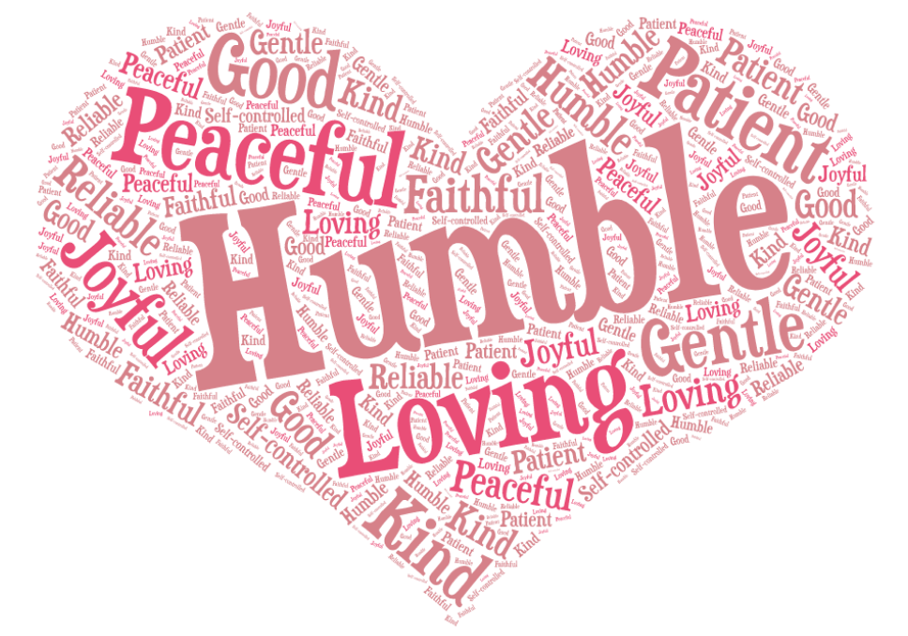
FRUITS OF THE SPIRIT
Loving
Joyful
Peaceful
Patient
Kind
Gentle and good
Faithful & reliable
Self-controlled
Humble
Notes:
Which of these fruits of the spirit are important for a leader to have?
Click…Loving,
Click…Joyful,
Click …Peaceful,
Click….Patient,
Click….Kind,
Click…Gentle and Good,
Click…Faithful and Reliable,
Click…Self-controlled,
Click…Humble
Do you have any of these fruits?
How do we do what we are called upon to do?
Consider the phrase “Random acts of Kindness”…
Webster’s Dictionary defines random as made, done, happening, or chosen without method or conscious decision. Think about times you have performed random acts of kindness . How did it affect you and the person you helped?
When are we supposed to be loving, joyful, peaceful, patient, kind, gentle and good, faithful and reliable, humble, and self-controlled? ………………….. All the time… at least we’re supposed to try!
Next slide

Slide 14
1 Corinthians 12:4-11
Now there are varieties of gifts, but the same Spirit; and there are varieties of services, but the same Lord; and there are varieties of activities, but it is the same God who activates all of them in everyone. To each is given the manifestation of the Spirit for the common good. To one is given through the Spirit the utterance of wisdom, and to another the utterance of knowledge according to the same Spirit, to another faith by the same Spirit, to another gifts of healing by the one Spirit, to another the working of miracles, to another prophecy, to another the discernment of spirits, to another various kinds of tongues, to another the interpretation of tongues. All these are activated by one and the same Spirit, who allots to each one individually just as the Spirit chooses.
Notes:
A reading from the first letter of St, Paul to the Corinthians
Click
(read)
In response to questions from Corinth, Paul describes what spiritual gifts are, who receives them, and what they are for. His emphasis is that particular spiritual gifts do not make believers spiritual. Every believer is spiritual because every Christian has God's Spirit within him or her. In addition, the Spirit gives one or more spiritual gifts to each believer to be used to serve the church. The church is like a body, in which every part is needed, and all the parts exist to serve one another. Every person must discover how they are gifted by the Spirit and value the function they serve in Christ's body.
In the Catholic Women’s League, these gifts are used to fill various roles throughout the organization. Whether your gift is praying, working, administration or others, they are all needed to serve God and our CWL.
Next slide

Slide 15
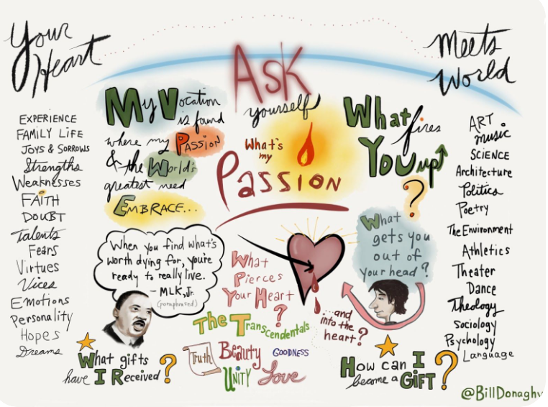
Notes:
Discerning your calling
Not everyone is called to all things….some of us have strong leadership skills but maybe dislike craftsmanship or caregiving. Some of us love to share our knowledge and the Gospel of Christ with others…either in a group setting or individually. These are the ladies that may assist with welcoming new persons to the group, to going into the community to encourage and assist with various jobs like visiting in the nursing homes or leading the Spiritual components of our meetings.
Every group requires leadership to bring things together, set the tone of the meetings and gatherings. Could this be you?
Of the gifts we just spoke about, there are some that would be of importance for a leader / president / committee chairperson to have.
Next slide

Slide 16
Discerning your calling
Leadership gifts: Administration, Discernment, Faith, Giving, Knowledge, Serving, Teaching, Wisdom, Communication
What is the greatest obstacle to allowing your name to be considered for an executive position in the League?
Is God calling you to serve as a member of the executive?
Notes:
Click
If you possess two or three of these skills, you could be in an executive position in the League. Remember, we aren’t asking you to be perfect, but only to be open to the calling to serve, learn from the mentorship of those who came before you, and have the ability to ask questions, especially up to the diocesan council members if you don’t know or are unsure of an answer.
Click
What is the greatest obstacle to allowing your name to be considered for an executive position in the League?
God has gifted each of us. We use and develop God-given gifts to use in the service of God’s people. He calls us to SERVICE….and we are called to SERVICE in our Mission statement.
Click
Is God calling you to serve as a member of the executive? Please pray and consider letting your name stand for positions at your council or higher levels.
Next slide

Slide 17
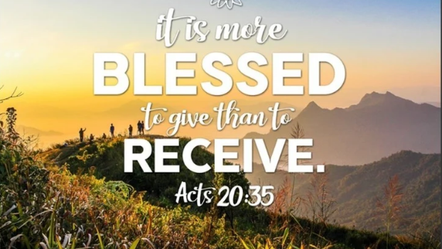
Notes:
Yes, it is still blessed to receive too -- but think how many blessings you will receive by your giving and good works in God’s name. Learning to express your opinions, how to conduct and participate in a Zoom meeting, how to compose reports and newsletters, how to use a camera, ways to inspire others, how to write prayers, and even how to mentor others with no experience.
Next slide

Slide 18
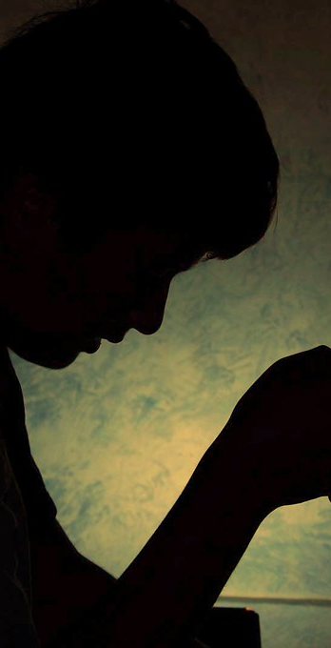
Prayer is at the heart of the discernment process. If you truly desire to discover where God is calling you, you can only discover that in conversation with God.
(Archdiocese of Brisbane, Australia)
﻿
Notes:
Prayer…Discernment….they go hand in hand. The Archdiocese of Brisbane, Australia has put out this message…prayer is at the heart of the discernment process. If you truly desire to discover where God is calling you, you can only discover that in conversation with God.
We ask that you pray about the needs of your council, and the gifts you have received or are open to receiving.
Fr. Pierre Teilhard de Chardin, S.J. sums up the discernment process so eloquently:
Above all, trust in the slow work of God. We are, quite naturally, impatient in everything to reach the end without delay.
We are impatient of being on the way to something unknown, something new…
And so I think it is with you. Your ideas mature gradually. Let them grow; let them shape themselves, without undue haste.
Only God could say what this new spirit gradually forming within you will be. Give our Lord the benefit
of believing that his hand is leading you and accept the anxiety of feeling yourself in suspense and incomplete.
Above all trust in the slow work of God.
Pause
Let’s join together in our closing prayer, written by Bishop George J Lucas of Australia.
Next slide

Slide 19
My God,
You have created me out of love to know you, love you
and serve you in a way no one else can do.
Your plans for me are far greater than any
I might dare dream for myself.
Lord, grant that I might be open to your grace
to know the next good step in your plan for my life.
Give me the courage and the generosity to say “Yes”!
Show me your will for me,
O Lord, and help me to say with Mary,
“I am the servant of the Lord: let it be done to me according to your word. Amen.
(Bishop George J. Lucas)
Notes:
My God…..
AMEN
Next Slide

Slide 20
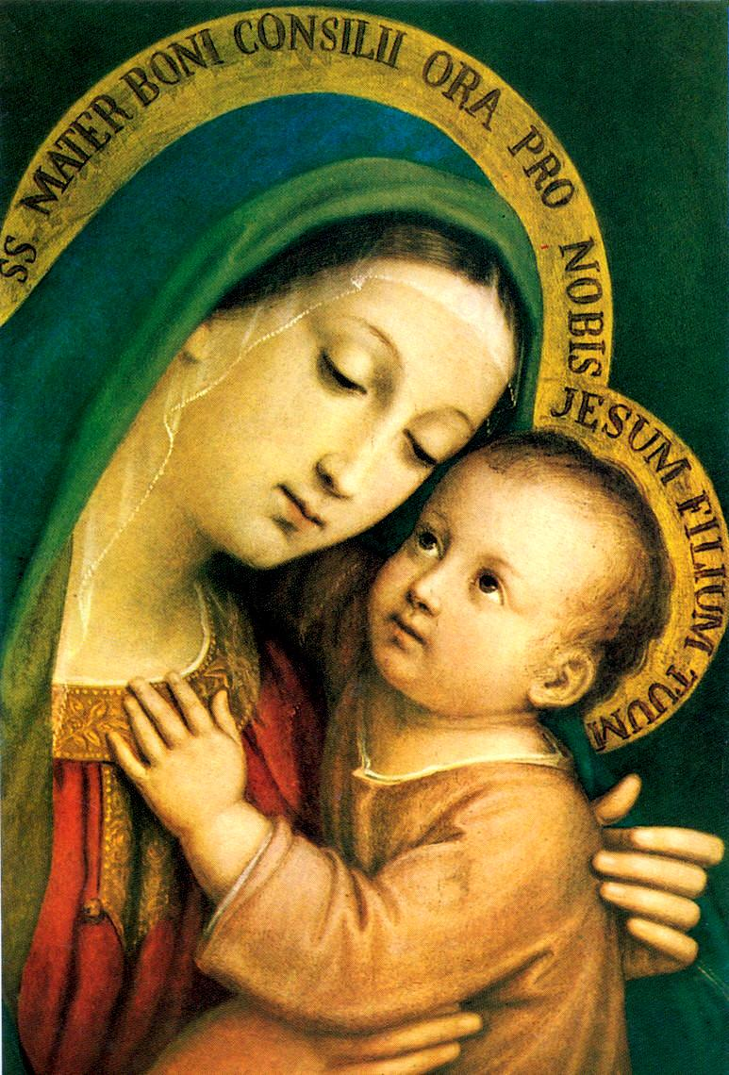
Thank you for joining us today.
May our Lady of Good Counsel pray for us!
Notes:
Thank you for joining us today.
Click
May Our Lady of Good Counsel, pray for us!
Amen
End presentation

